Slide 1



Module #4 – Software Black-Box Testing Methods
Software Testing
Topic #4 – Category Partition Testing Method
Instructor: Jerry Gao, Ph.D., Professor
San Jose State University
Notes:
From this session, we start to Module #2 on Software Testing Fundamentals.
In this module, we cover the basics of software testing, including the following subjects:
Topic #1 - Software Problem Management
Topic #2 - Software Test Design
Topic #3 - Software Test Management

Slide 2
Topic #4 – Decision Table Testing METHOD
Software Testing
What is Category Partition Testing?
Category Partition Main Characteristics
How to Perform Category Partition Methods
Category Partition Testing Examples
Category Partition Testing Summary
Notes:
This is the first package in Module 3 for Software Testing Class. It provides an introduction to software white-box testing. It covers the following
What is white-box testing?
Why Is white-box testing important?
Who does white-box testing?
White-box testing focuses
White-box testing coverage

Slide 3
Topic #4 – Category PARTITION TEST METHOD
Software Testing
What is category partition testing method?
Category Partition Method [CPM] is a specification based testing technique helping the testers create test cases by refining the functional specification of a program into test requirements.
The idea behind category partition testing is to divide the input domains of a component into N different disjoint partitions and select one value from each input domain to create a test case.
This method emphasizes both the specification coverage and error detection aspects of testing

Slide 4
Topic #4 – Category PARTITION TEST METHOD
Software Testing
Main Characteristics
The test specification is concise and uniform representation of test information for a function
The partition can be easily modified and gives the tester a logical way to control the volume the tests.
The generator tool provides an automated way to produce thorough tests which avoids impossible or undesirable tests.

Slide 5
Topic #4 – Category PARTITION TEST METHOD
Software Testing
Category Partition Systematic Method
According to T.J Ostrand and M.J.Balcer , he proposed a systematic method consisting of the following steps :
Decompose function specifications into functional units.
Identify parameters and environment conditions.
Find categories of information.
Partition each category into choices.
Write test specification for each unit.
^{Produce test frames.}
^{Generate test cases.}

Slide 6
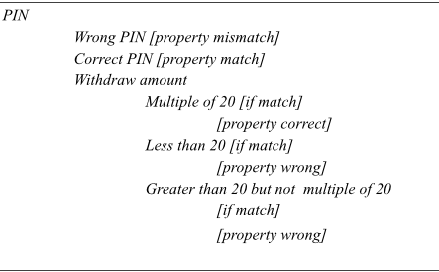
Topic #4 – Category PARTITION TEST METHOD
Software Testing
Partition Testing Example
Example 1 : Test Specification for ATM – PIN Number
Partition:

Slide 7
Topic #4 – Category PARTITION TEST METHOD
Software Testing
An Example of using Category Partition Method
Example 2:
Test a command-line program that supports “find” operation as follows:
Command: find
Syntax: find <pattern> <file>
Function Specifications:
The find command is used to locate one or more instances of a given pattern in a text file.
All lines in the file that contain the pattern are written to standard output.
A line containing the pattern is written only once, regardless of the no. of times the pattern occurs in it.
The pattern is any sequence of characters whose length does not exceed the maximum length of a line in the file.
To include a blank in the pattern, the entire pattern must be enclosed in quotes (“). To include a quotation mark in the pattern, two quotes in a row (“ ”) must be used.

Slide 8
Topic #4 – Category PARTITION TEST METHOD
Software Testing
An Example of using Category Partition Method
Examples:
find john myfile
- displays lines in the file myfile which contain john
^{find “john smith” myfile}
- display lines in the file myfile which contains john smith.
^{find “john” ” smith” myfile}
- display lines in the file which contains john” smith.
When file is considered as a parameter, we need to consider the following:- no. of occurrences of the pattern in the file.- no. of occurrences of the pattern in a line that contains it.- maximum line length in the file
Notes:
White-box software testing focuses on the following areas:
– Program control/execution paths → to make sure that executable program control flows
can be correctly executed.
Program data → to make sure that program data parameters and values are properly set-up and
accessed.
-

Slide 9
Topic #4 – Category PARTITION TEST METHOD
Software Testing
An Example of using Category Partition Method
Test specification for Find command:
Parameters :
Pattern Size:
empty
single character
many character
longer than any line in the file
2. Quoting:
Pattern is quoted
Pattern is not quoted
Pattern is improperly quoted
Notes:
White-box software testing focuses on the following areas:
– Program control/execution paths → to make sure that executable program control flows
can be correctly executed.
Program data → to make sure that program data parameters and values are properly set-up and
accessed.
-

Slide 10
Topic #4 – Category PARTITION TEST METHOD
Software Testing
An Example of using Category Partition Method
Test specification for Find command:
Parameters:
Embedded blanks:
No embedded blank
One embedded blank
Several embedded blanks
2. Embedded quotes:
No embedded quotes
One embedded quotes
Several embedded quotes
Parameters:
File name:
Good File name
No File name
Omitted
Environment:
(only for the pattern)
File access environment:
File not accessible
File can’t read
File can’t open
Notes:
White-box software testing focuses on the following areas:
– Program control/execution paths → to make sure that executable program control flows
can be correctly executed.
Program data → to make sure that program data parameters and values are properly set-up and
accessed.
-

Slide 11
Topic #4 – Category PARTITION TEST METHOD
Software Testing
An Example of using Category Partition Method
Parameters:
Environment: (only for the pattern)
No. of occurrences of pattern in the file:
None
Exactly one
More than one
Pattern occurrences on target line:
One
None
More than one
Notes:
White-box software testing focuses on the following areas:
– Program control/execution paths → to make sure that executable program control flows
can be correctly executed.
Program data → to make sure that program data parameters and values are properly set-up and
accessed.
-

Slide 12
Topic #4 – Category PARTITION TEST METHOD
Software Testing
An Example of using Category Partition Method
Pattern
Embedded
blanks
Embedded
quotes
Pattern Size
Quoting
empty
single character
many character
longer than any line in the file
Pattern is quoted
Pattern is not quoted
Pattern is improperly quoted
No embedded blank
One embedded blank
Several embedded blanks
No embedded quotes
One embedded quotes
Several embedded quotes
Notes:
White-box software testing focuses on the following areas:
– Program control/execution paths → to make sure that executable program control flows
can be correctly executed.
Program data → to make sure that program data parameters and values are properly set-up and
accessed.
-

Slide 13
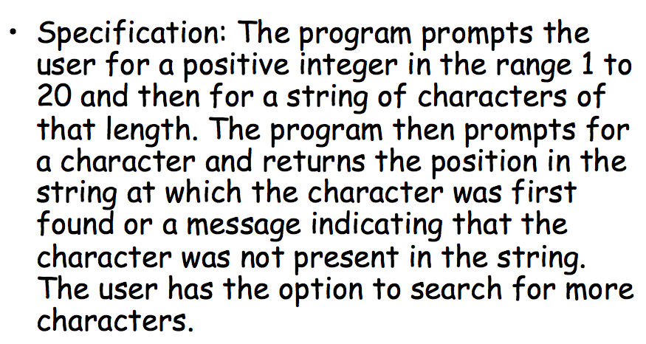
Topic #4 – Category PARTITION TEST METHOD
Software Testing
An Example of using Category Partition Method
Example 2 :
Notes:
White-box software testing focuses on the following areas:
– Program control/execution paths → to make sure that executable program control flows
can be correctly executed.
Program data → to make sure that program data parameters and values are properly set-up and
accessed.
-

Slide 14
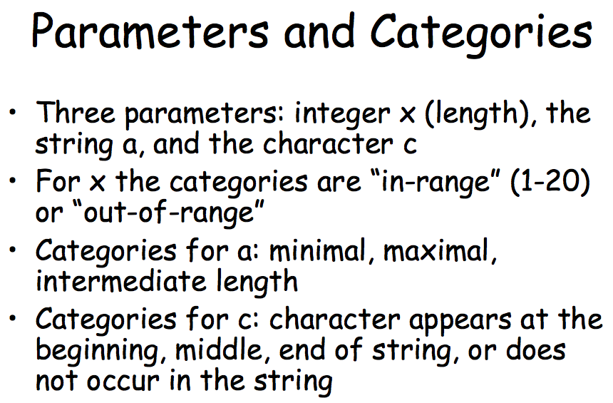
Topic #4 – Category PARTITION TEST METHOD
Software Testing
An Example of using Category Partition Method
Example 2:
Notes:
White-box software testing focuses on the following areas:
– Program control/execution paths → to make sure that executable program control flows
can be correctly executed.
Program data → to make sure that program data parameters and values are properly set-up and
accessed.
-

Slide 15
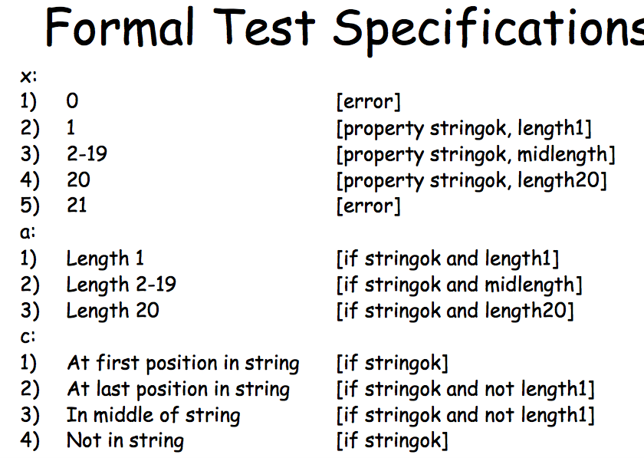
Topic #4 – Category PARTITION TEST METHOD
Software Testing
An Example of using Category Partition Method
Example 2:
Notes:
White-box software testing focuses on the following areas:
– Program control/execution paths → to make sure that executable program control flows
can be correctly executed.
Program data → to make sure that program data parameters and values are properly set-up and
accessed.
-

Slide 16
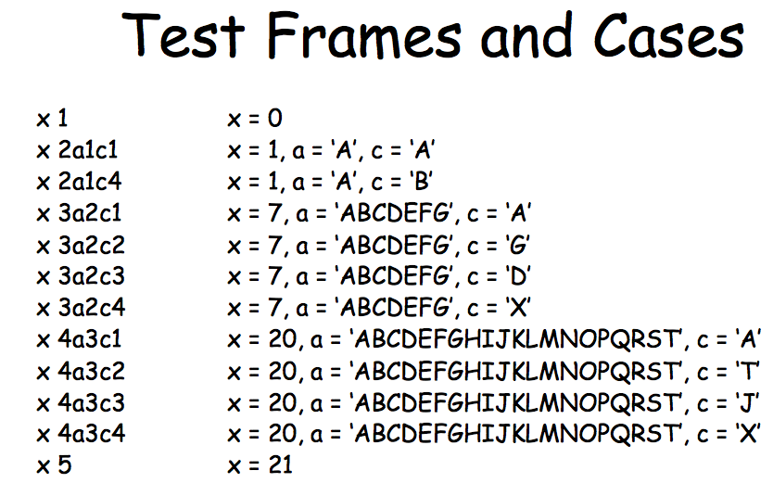
Topic #4 – Category PARTITION TEST METHOD
Software Testing
An Example of using Category Partition Method
Example 2:
Notes:
White-box software testing focuses on the following areas:
– Program control/execution paths → to make sure that executable program control flows
can be correctly executed.
Program data → to make sure that program data parameters and values are properly set-up and
accessed.
-

Slide 17
Topic #4 – Category PARTITION TEST METHOD
Software Testing
Category Partition Testing Summary
Advantage:
The tester can modify the test specification whenever necessary
Reduce the number of test cases.
Provides logical way to control the volume of tests.
Language or implementation independent
Test Coverage:
Each of the categorized partition has a test case derived from it.
Test frames are generated which consist of maximum combination of choices in the category that is being partitioned.
Limitations:
Lack of systematic methods to partition input domains of a component for the given non-formal function specification.
Does not unearth bugs due to incorrect specifications.
Challenges:
- Identifying the parameters and environments, conditions and categories requires experienced tester.
Notes:
White-box software testing focuses on the following areas:
– Program control/execution paths → to make sure that executable program control flows
can be correctly executed.
Program data → to make sure that program data parameters and values are properly set-up and
accessed.
-

